Slide 1
UI design
A history of web design trends
Lectured by:
Nguyễn Hữu Hiếu

Slide 2
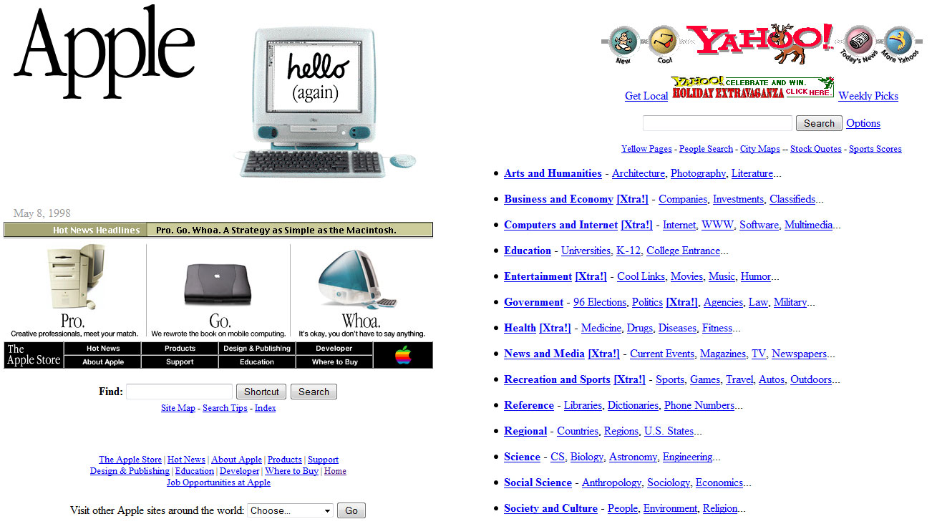
In the beginning (1995 – early 2000’s)
Simple text-based sites built in the first generation of HTML
Web and software developers dedicated a great deal of time to making menus, buttons and links look overtly ‘clickable’, in order to to coax users to move from page to page.

Slide 3
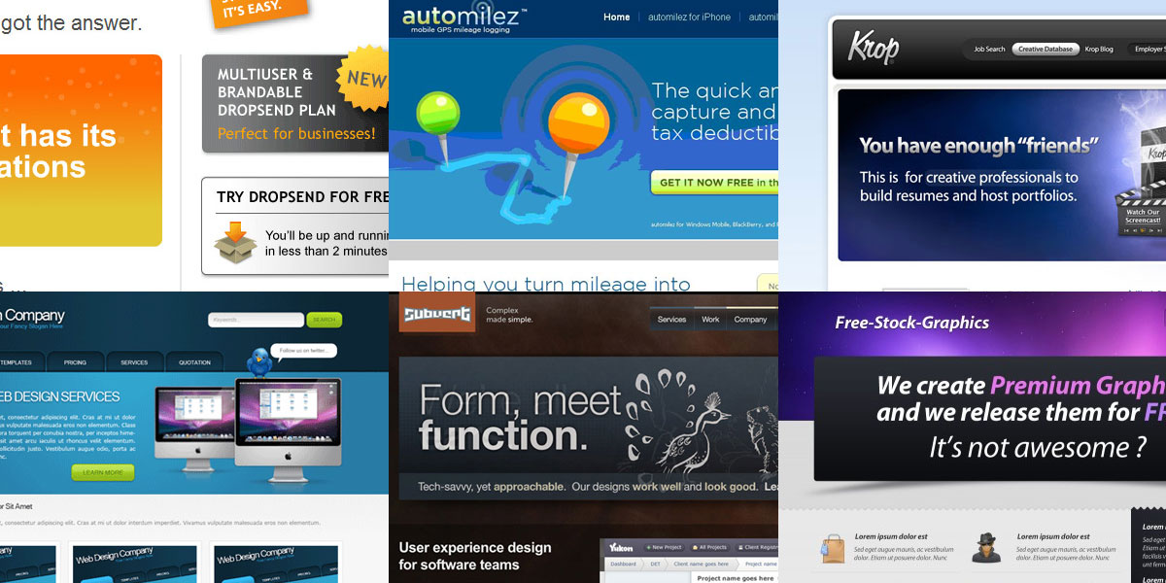
Web 2.0 (2003 – 2010)
Think lengthy drop shadows, shiny bubbles, oversized buttons and glares
The oversized graphics trained us to ‘click here’ and ‘learn more’ all the while serving up a feast for our eyes as colour, gradients and graphics tantalised our senses.

Slide 4
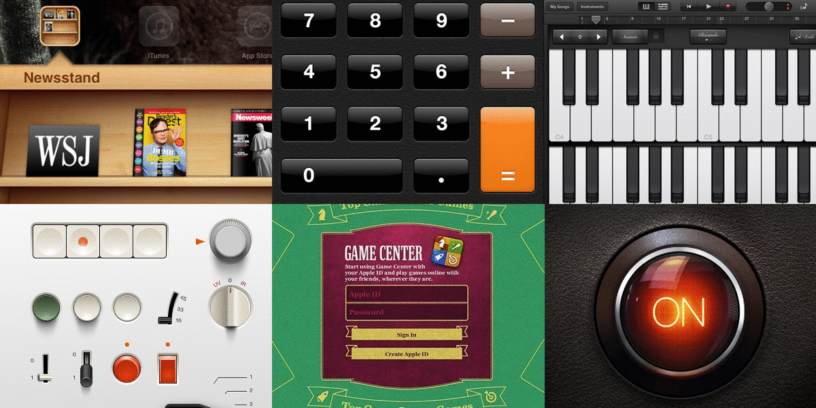
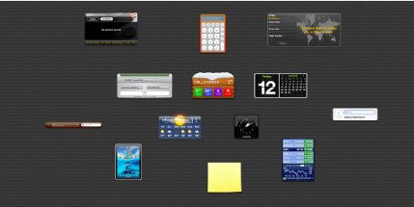
Skeuomorphic design (2010 – 2012)
This is the practice of incorporating the visual characteristics of an object into a digital design
Texture, light and
colours unite
to create a sense
of depth and realism

Slide 5
Flat design (2012 – now)
Flat design is the latest style to hit the digital design world
Simplicity is key: decorative elements such as gradients, textures and reliefs are avoided
The style utilises open space, bright colours, sharp edges and two-dimensional illustrations with a strong focus on usability
Omitting complex graphics means that users have less distraction and can focus on content.
By discarding unnecessary styling, page load time is significantly reduced and code is cleaner meaning sites adapt effortlessly across multiple platforms.

Slide 6
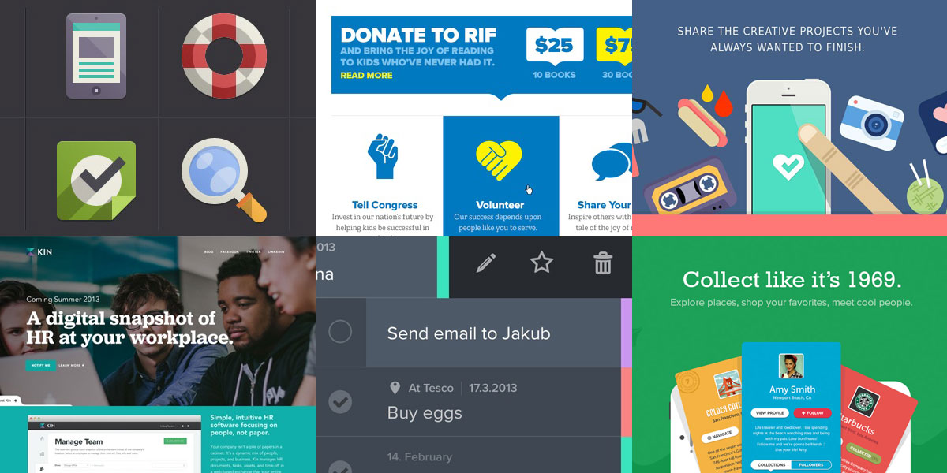
Flat design (2012 – now)
Microsoft was an early adopter, applying flat design to their Windows 8 interface.

Slide 7
CSS framework

Slide 8
CSS Framework
https://www.mockplus.com/blog/post/css-framework
https://cssdb.co/
Libraries:
https://codepen.io/
https://emilkowalski.github.io/css-effects-snippets/
https://speckyboy.com/css-libraries-frameworks-tools-2020/
https://www.webdesignerdepot.com/2019/10/15-best-css-libraries-for-2019/

Slide 9
Tài Liệu Tham Khảo
[1] Unix Network Programming, Vol. 1, Third Edition, The Sockets Networking API, W. Richard Stevens, Bill Fenner, Andrew M. Rudoff, Addison Wesley, 2003
https://www.butterfly.com.au/blog/design/ui-design-a-history-of-web-design-trends

